Slide 1

Long Short Term Memory Network (LSTM)

Slide 2


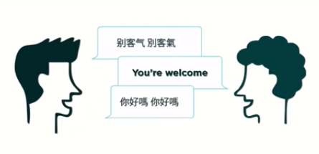
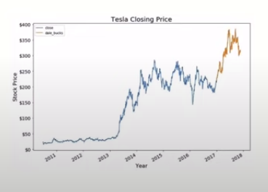
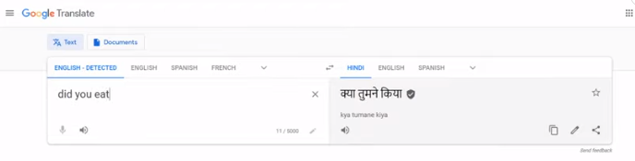
Applications of RNN
Speech Recognition
Language Translation
Prediction Problems
Speech Translation
Source: Google Open source Images

Slide 3
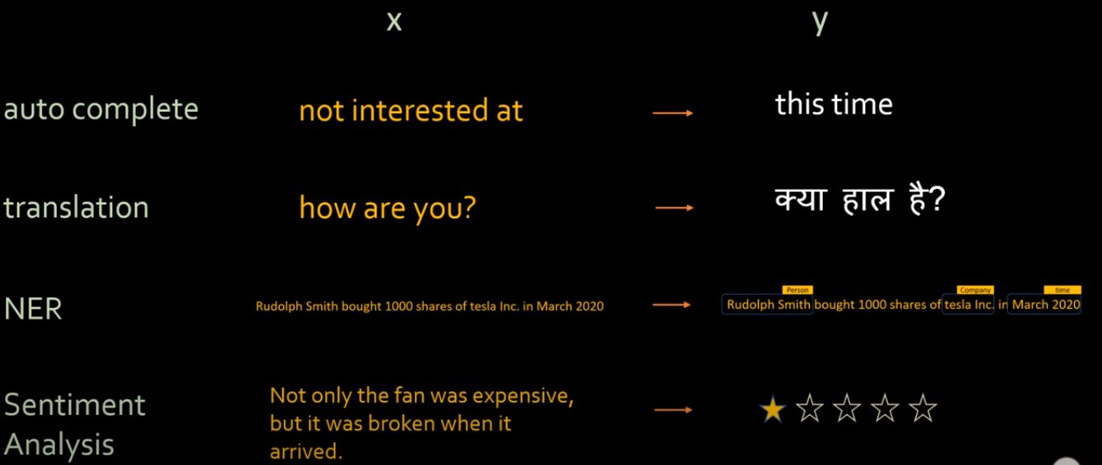
Applications of RNN
Named Entity Recognition
Source: Google Open source Images

Slide 4
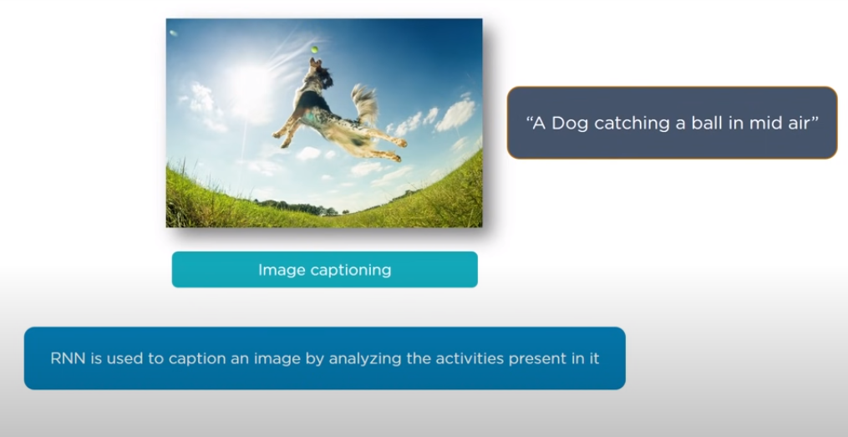
Applications of RNN
Source: Google Open source Images

Slide 5
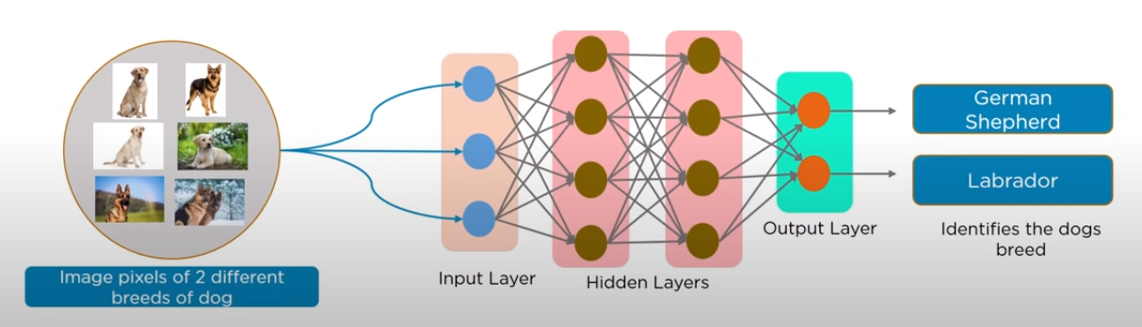
Recurrent Neural Networks(RNN)
Source: Google Open source Images

Slide 6
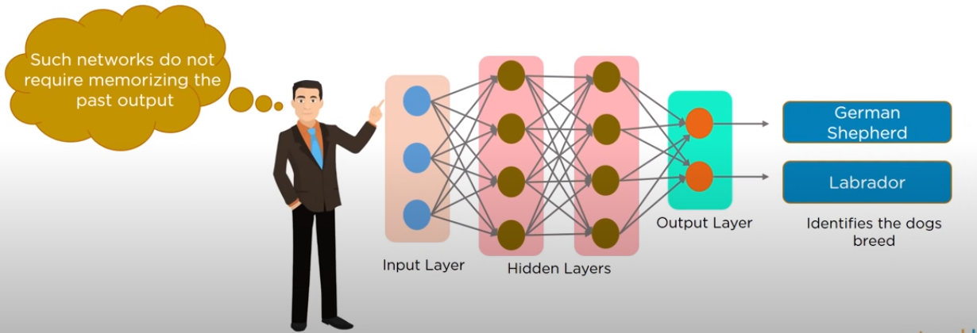
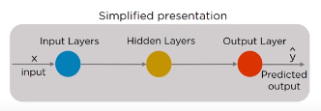
Recurrent Neural Networks(RNN)
Decisions are based on the current input
No memory about the past
No Future scope
Source: Google Open source Images

Slide 7
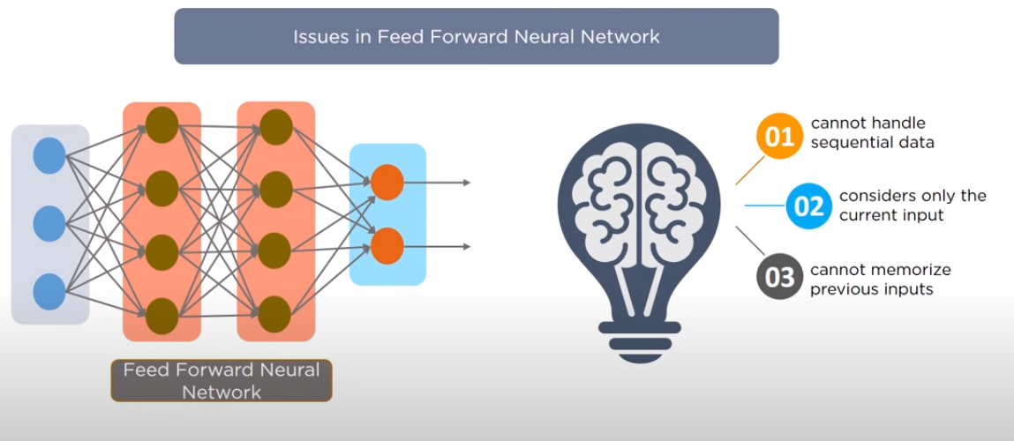
Why Recurrent Neural Networks(RNN)?
Source: Google Open source Images

Slide 8
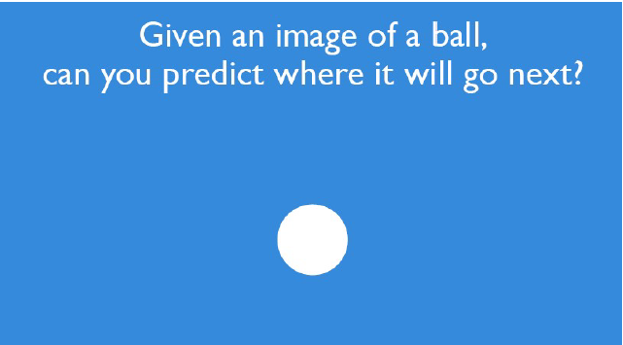
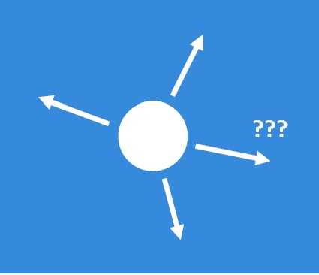
Recurrent Neural Networks(RNN)

Slide 9

Recurrent Neural Networks(RNN)

Slide 10
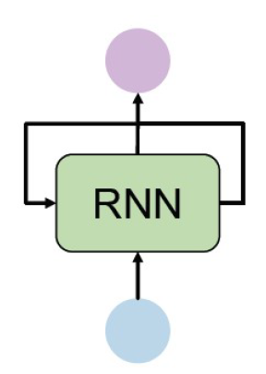
Recurrent Neural Networks(RNN)

Slide 11
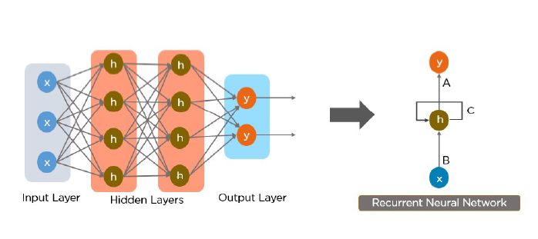
Recurrent Neural Networks(RNN)

Slide 12
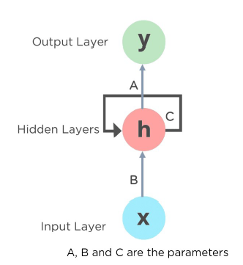
Recurrent Neural Networks(RNN)
Network Framework

Slide 13
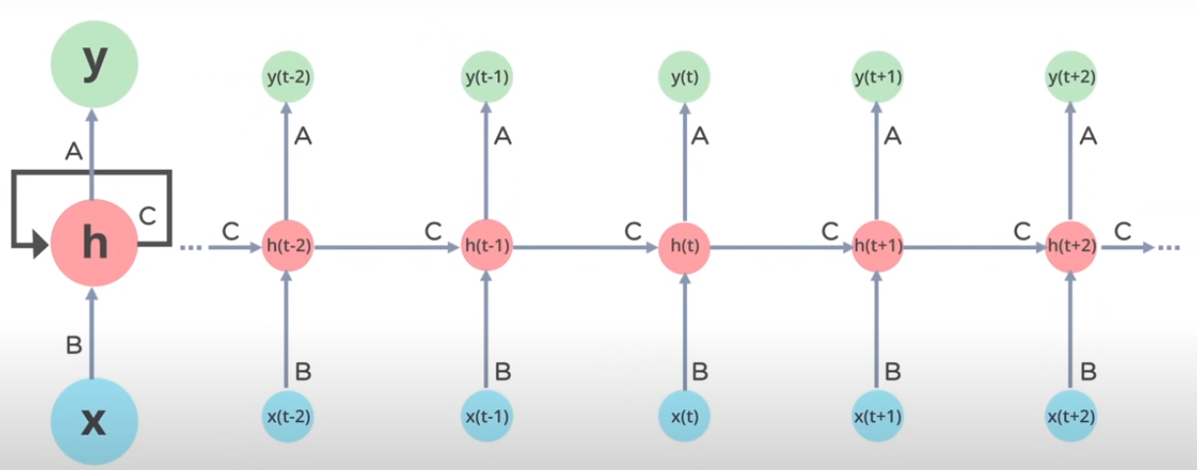
Recurrent Neural Networks(RNN)
Network Time Sequence Expansion

Slide 14
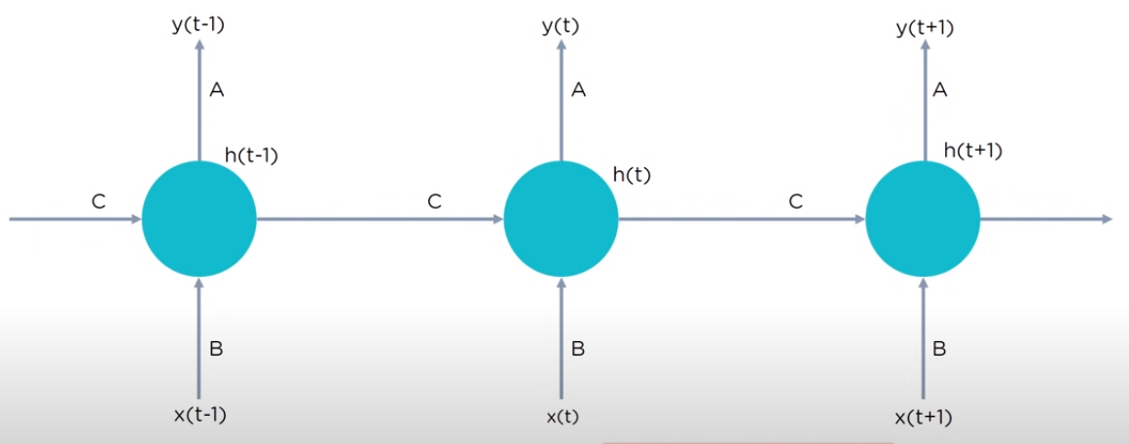
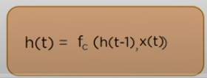
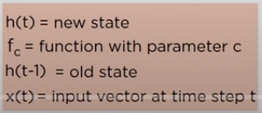
Recurrent Neural Networks(RNN)

Slide 15
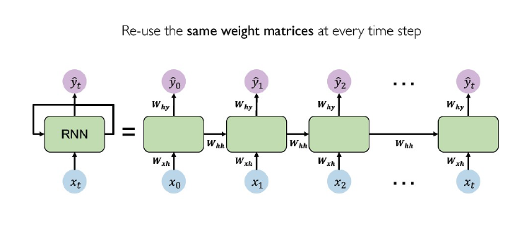
Recurrent Neural Networks(RNN)
RNN Weight Matrices
Source: Fei-Fei Li and Andrej Karpathy and Justin Johnson

Slide 16
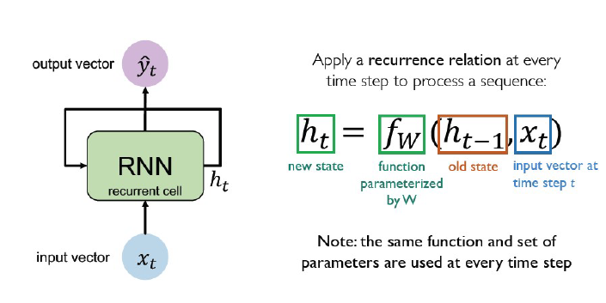
Recurrent Neural Networks(RNN)
Recurrent Cell
Source: Fei-Fei Li and Andrej Karpathy and Justin Johnson

Slide 17
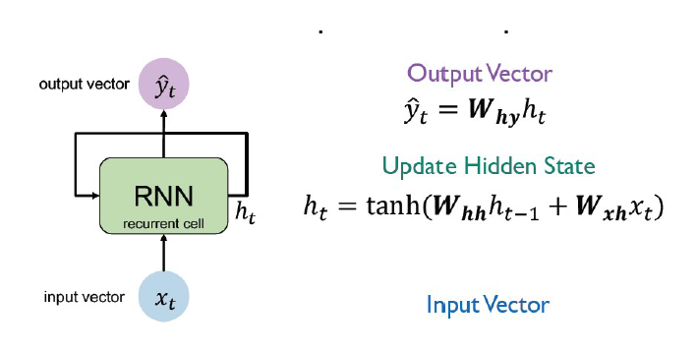
Recurrent Neural Networks(RNN)
Input, State Update, and Output
Source: Fei-Fei Li and Andrej Karpathy and Justin Johnson

Slide 18
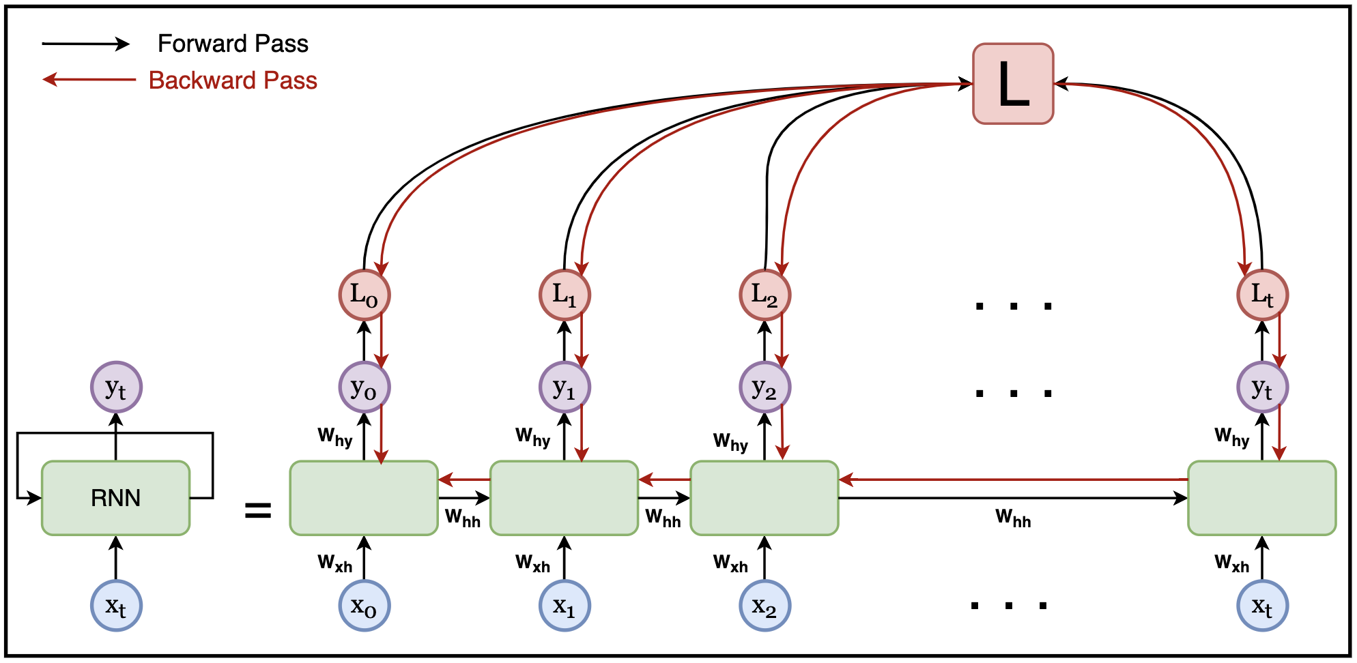
Recurrent Neural Networks(RNN)
Source: https://www.linkedin.com/pulse/bxd-primer-series-recurrent-neural-networks-mayank-k-/

Slide 19
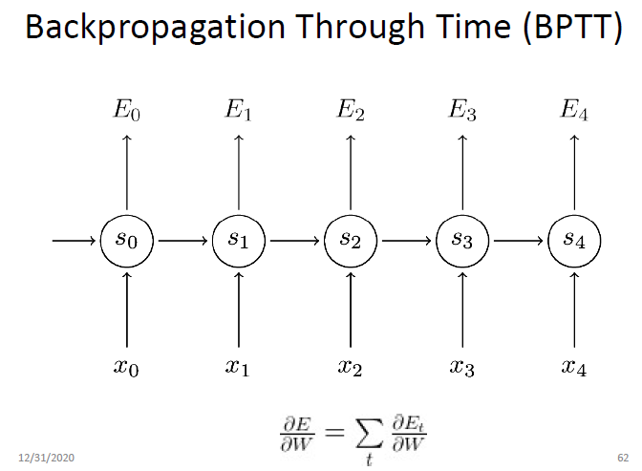
Recurrent Neural Networks(RNN)

Slide 20
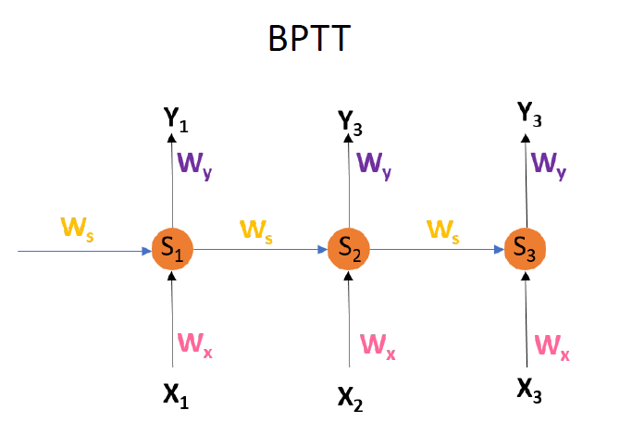


Recurrent Neural Networks(RNN)

Slide 21
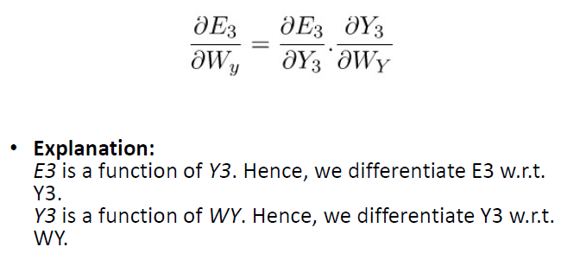
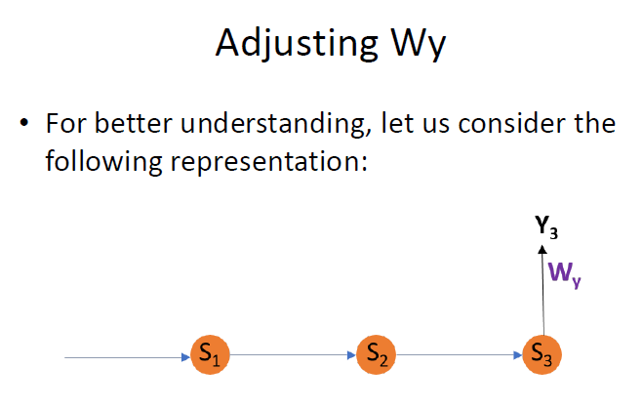
Recurrent Neural Networks(RNN)

Slide 22
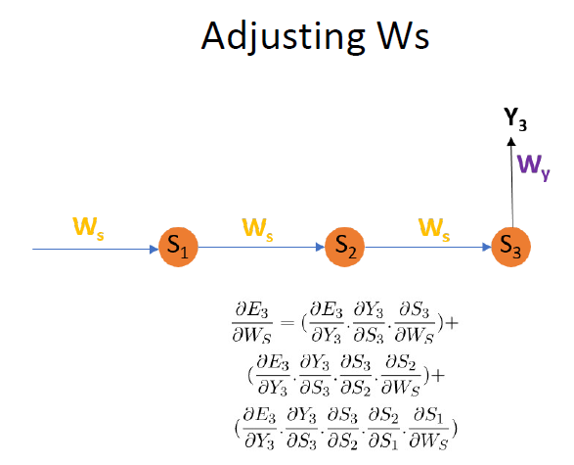
Recurrent Neural Networks(RNN)

Slide 23
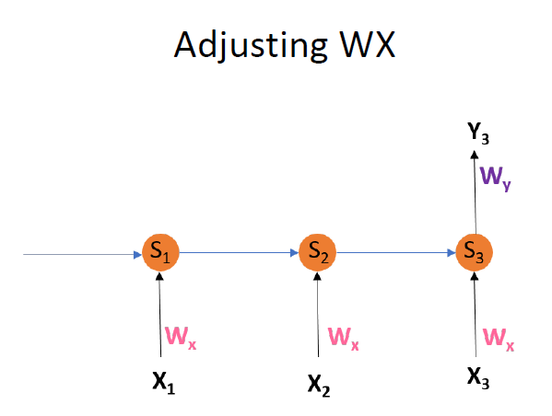
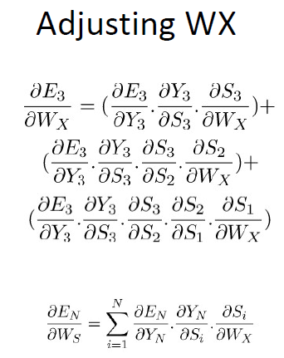
Recurrent Neural Networks(RNN)

Slide 24
Issues with RNN
Previous Information(Task)
E.g.: Previous Video Frame
Present Information(Task)
E.g.: Current Video Frame
Sometimes, we only need to look at recent information to perform the present task.
For E.g.: “The clouds are in the _____,”
  It’s pretty obvious the next word is going to be sky.
In such cases, where the gap between the relevant information and the place that it’s needed is small, RNNs can learn to use the past information.

Slide 25
Issues with RNN
Different Context:
  Consider trying to predict the last word in the text “I grew up in Karnataka… I speak fluent Kannada.”
Recent information suggests that the next word is probably the name of a language, but if we want to narrow down which language, we need the context of Karnataka, from further back.
It’s entirely possible for the gap between the relevant information and the point where it is needed to become very large.
Unfortunately, as that gap grows, RNNs become unable to learn to connect the information.

Slide 26
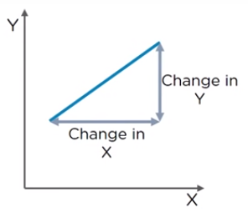
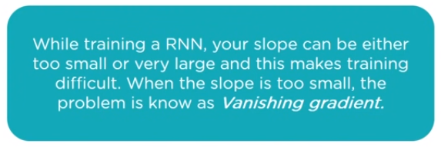
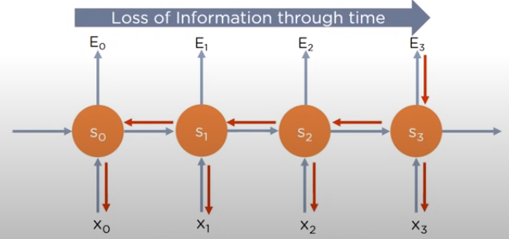
Recurrent Neural Networks(RNN)
Vanishing Gradient Problem
Back propagate the Error

Slide 27
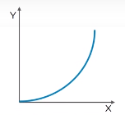
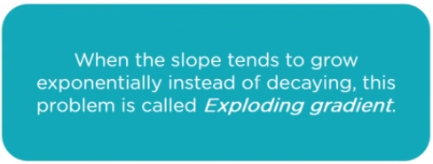
Recurrent Neural Networks(RNN)
Exploding Gradient Problem
Back propagate the Error

Slide 28
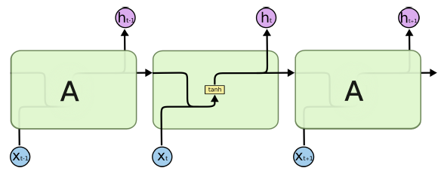
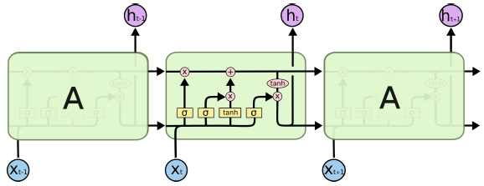
RNN vs LSTM

Slide 29
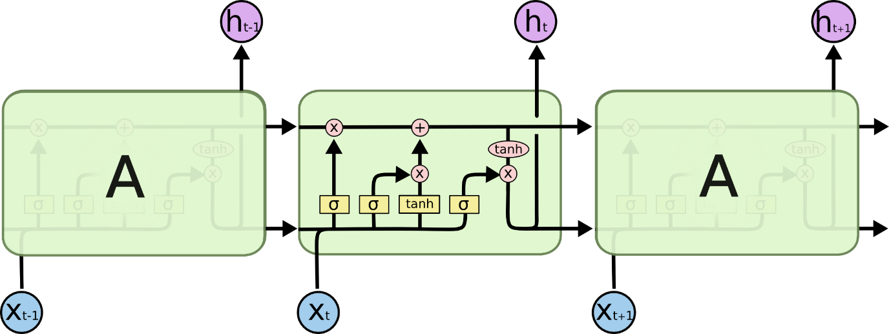
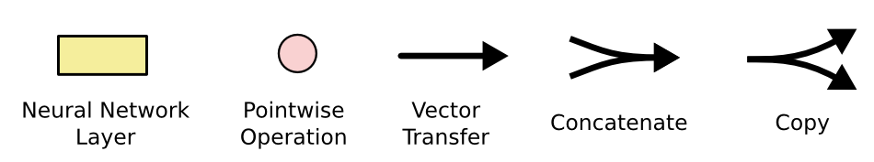
LSTM : Components

Slide 30
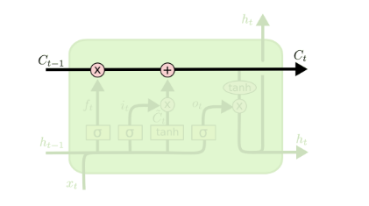
LSTM : Components – Memory Cell

Slide 31
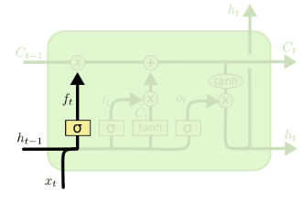

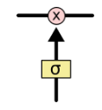
LSTM : Components – Forget Gate

Slide 32
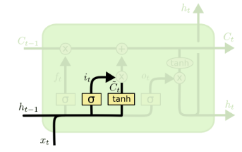

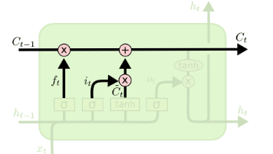

LSTM : Components – Input Gate

Slide 33
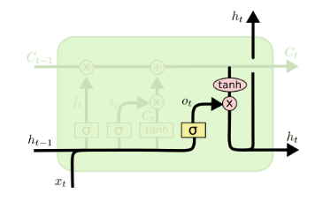
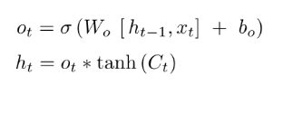
LSTM : Components – Output Gate

